Slide 1


Applying Systems Theory to the Nursing Metaparadigm
A Framework for Holistic Patient Care

Slide 2
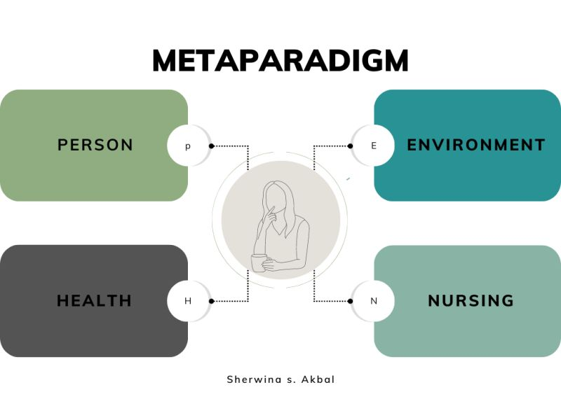
What is the Nursing Metaparadigm?
What is the Nursing Metaparadigm?
The four fundamental concepts that define nursing practice and knowledge (Fawcett, 2006, p. 6).
They provide a holistic perspective for understanding the patient and their health needs.
The four concepts are:
  Person: The recipient of care (individual, family, community).
  Environment: The internal and external surroundings that affect the person.
  Health: The holistic state of well-being of the person.
  Nursing: The actions, attributes, and science of the professional nurse.
Notes:
Implication for Practice: This metaparadigm mandates a holistic, person-centered approach, moving beyond a purely biomedical model to consider the full context of the patient's experience.

Slide 3
What is Systems Theory?
A foundational theory from general science that explains the structure and behavior of complex wholes (von Bertalanffy, 1968).
Main Ideas:
All parts of a system are connected and influence each other to work as a whole.
Smaller subsystems exist within larger ones, each serving a specific role.
Systems take in, process, and release energy or information to function effectively.
They adapt and maintain balance by learning from feedback and adjusting to change.
Interconnection to Nursing: This theory provides the "how" for the metaparadigm's "what," offering a structured lens to understand the dynamic interactions between Person, Environment, Health, and Nursing.
Notes:
Von Bertalanffy’s (1968) General Systems Theory provides a framework that links the nursing metaparadigm to practice by translating abstract concepts into functional models. As Fawcett (2005) explains, the metaparadigm offers a global view of nursing, guiding nurses to see patients as whole persons within their life context; an approach that systems theory helps put into action.

Slide 4

The Person as an Open System
Hannoodee and Dhamoon (2025) describe the Neuman Systems Model as a holistic framework emphasizing patient stability through the identification and reduction of stressors.
The Person is an open system constantly interacting with the environment.
Inputs: Oxygen, nutrients, information, social support, stressors.
Throughput: The body and mind process inputs. Biological (metabolism, immune response), psychological (coping), social (communication) processes.
Outputs: Physical activity, communication, waste products, behaviors.
Subsystems: Biological (cardiovascular, nervous), psychological, social, and spiritual systems.
Impact on Practice: Assessment must evaluate all subsystems and their interactions, not just the presenting problem.

Slide 5
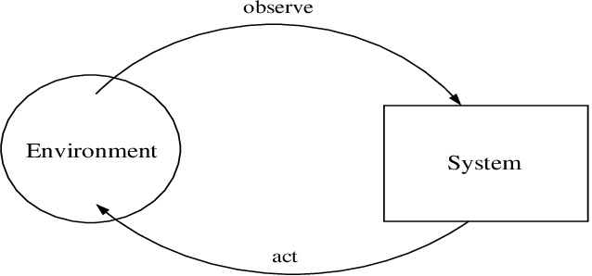
The Environment as Multiple Interacting Systems
The Environment is not a single entity but a series of nested and overlapping systems (von Bertalanffy, 1968).
Subsystems of the Environment:
  Internal Environment: The person's physiological and psychological state.
  Microsystem Environment: Immediate Surroundings (Home, family, work).
  Distal Environment: Community, healthcare system, culture, economy.
A change in any environmental subsystem (e.g., loss of a job) can be an input that affects the person's system.
Impact on Practice: Nurses must assess beyond the hospital room to identify environmental inputs that facilitate or impede health.

Slide 6
Health as a Dynamic State of the System
Health is the state of the entire person-system; it is a continuous process of adaptation.
It represents a state of dynamic equilibrium (homeostasis) where the system can effectively manage inputs and stressors.
Illness represents a state of entropy; system disorganization and instability.
Nursing aims to foster negative entropy; increasing order and stability through energy input (care).
High-level wellness exists when the system has the energy and adaptability to grow and thrive.
Impact on Practice: Goals shift from merely "curing" to "promoting stability, adaptation, and growth.

Slide 7
Nursing as the Regulator and Processor
Nursing is the external (and sometimes internal) force that helps regulate the person-system.
The nurse provides planned inputs (medications, education, emotional support).
The nurse facilitates effective throughput (e.g., helping a patient understand and process a new diagnosis).
The goal is to achieve a positive output (improved health status, self-care ability).
Process:
  Assess system disorganization (inputs, throughputs, outputs).
  Diagnose points of breakdown.
  Plan specific, goal-oriented interventions.
  Intervene with targeted inputs (e.g., medication, education, advocacy).
  Evaluate outputs and feedback to adjust the care plan.
Impact on Practice: The nurse's role is explicitly defined as a proactive, analytical system regulator.

Slide 8
Clinical Application: A Systems View of Post-Surgical Recovery
Situation: Mr. Lee, 72, following hip replacement surgery.
Person System:
  Subsystems: Biological (pain, immobility), Psychological (fear of falling), Social (lives alone).
Environmental Inputs:
  Microsystem: Home with stairs; daughter's support.
  Macrosystem: Access to home health services.
Health State: Dynamic equilibrium is disrupted (entropy high).
Nursing Interventions (Regulatory Inputs):
  Pain management, physical therapy, patient education, arranging home health.
Feedback Loop: Mr. Lee's reported pain level and demonstrated mobility (outputs) guide medication and therapy adjustments.
Evidence: Research shows that systems-based, multidisciplinary care plans significantly reduce fall rates and improve functional outcomes in elderly post-surgical patients (Ma et al., 2022).

Slide 9
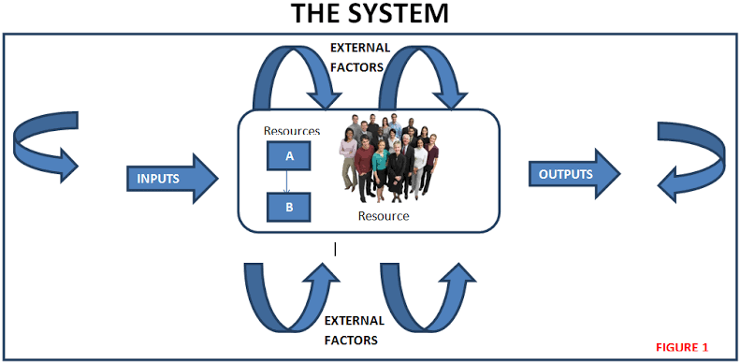
A Change in One Part Affects the Whole
Systems Theory provides a robust, interdisciplinary framework that gives functional structure to the nursing metaparadigm.
Clinical Example:
  A change in the Person's biological subsystem (e.g., a diabetes diagnosis).
  Affects their Health and requires new self-care behaviors.
  This changes their Environment (diet at home, frequent clinic visits).
  This necessitates Nursing interventions (education, support) to help the entire system adapt.
  The integration of these theories is not just academic; it is essential for delivering safe, effective, and truly person-centered care in an increasingly complex healthcare environment.

Slide 10
Summary: A Unified View
Systems Theory provides a powerful lens for understanding the Nursing Metaparadigm.
It demonstrates that the four concepts are not separate, but are interrelated parts of a single, dynamic nursing process system.
The nurse's role is to assess, intervene, and evaluate within this complex, living system to promote stability, growth, and health.

Slide 11
References
Fawcett, J. (2006). Contemporary nursing knowledge: Analysis and evaluation of nursing models and
theories (2nd ed.). F. A. Davis Company. https://dlib.phenikaa-uni.edu.vn/bitstream/PNK/381/1/2.%20Contemporary%20Nursing%20Knowlege_Fawcett.pdf
Hannoodee, S., & Dhamoon, A. S. (2025). Nursing Neuman systems model. In StatPearls [Internet].
StatPearls Publishing. https://www.ncbi.nlm.nih.gov/books/NBK560658/
Ma, Y., Wang, A., Lou, Y., Peng, D., Jiang, Z., & Xia, T. (2022). Effects of frailty on outcomes following
surgery among patients with hip fractures: A systematic review and meta-analysis. Frontiers in Medicine, 9, 829762. https://doi.org/10.3389/fmed.2022.829762
von Bertalanffy, L. (1968). General system theory: Foundations, development, applications. George
Braziller. https://monoskop.org/images/7/77/Von_Bertalanffy_Ludwig_General_System_Theory_1968.pdf

Slide 12

Thank you
Ekundayo Adelaja
Beal University Canada
NU 220: Professional Nursing
Dr. Miranda Bevilacqua
November 11, 2025.

